Slide 1
Data Structures and Algorithms IICT-6005
Lesson 14 – Pseudo Random Number Generators

Slide 2
What is a Random Number?
A true random number can be defined as:
Any one number that is drawn from a set of possible values having uniform distribution.
This means that each number in the set has equal chances of being selected as the random number.
Example: If a random number from 1 to 10 is to be selected, all numbers have exactly 10% chance of being selected as our random number.
2
Notes:
5/5/2020
2
2

Slide 3
What is a Random Number?
A sequence of true random numbers can be defined as:
Any set of numbers drawn from a set of possible values having both uniform distribution and statistical independence.
This means that, not only do all the numbers have equal chances of being part of the random sequence of numbers, but the selection of any one number should not affect the chances of any other number being selected. Example: If 2 random numbers from 1 to 10 are to be selected, if our first random number is 1, this does not make it any more (or less likely) that our second random number will be 2.
3
Notes:
5/5/2020
3
3

Slide 4
Is Random Really Random?
For a number to be truly random it must be generated in such a way that it value could not be predicted beforehand.
There are several ways that one can generate a random number in real life
Can a computer generate a TRUE RANDOM NUMBER?
A computer follows its instructions blindly and is therefore if the algorithm for generating random number is known, then random number generation using computers can become completely predictable – it is a deterministic machine with no inherent randomness!
4
Notes:
5/5/2020
4
4

Slide 5
Is Random Really Random?
Therefore, in Computational Random Number Generation, the numbers appear to be random but in reality they are not!
We call these Pseudo-Random Numbers meaning that…
Although the numbers may appear to be random, there is actually a well-defined process in the background to generate them.
Such processes often use mathematical formulae and a seed to generate the random numbers
5
Notes:
5/5/2020
5
5

Slide 6
Is Random Really Random?
The fact that these random numbers were determined using a mathematical formula means they are also :
Deterministic: The random number (or sequence of random numbers) can be reproduced if the algorithm and the seed are known.
Periodic: The random number (or sequence of random numbers) will eventually repeat itself
All forms of Computational Random Number Generation suffer from these 2 problems
6
Notes:
5/5/2020
6
6

Slide 7
Is Random Really Random?
To generate a True Random Number computationally, it is necessary to extract randomness from physical phenomena and introduce these as inputs to the random number generation algorithms.
Example:
Variations in somebody's mouse movements
The amount of time between keystrokes.
Atmospheric or background noise
The time at which a radioactive source decays
These inputs are almost impossible to replicate exactly and are usually provided as inputs to complex algorithms.
The random number generation in this case can approach true randomness i.e. the numbers generated are both unpredictable and hard to replicate.
7
Notes:
5/5/2020
7
7

Slide 8
Pseudo Random Number Generators
A good deal of research has gone into this Pseudo Random Number Generation because computationally generated random numbers can be quite useful for:
Data Encryption keys for Cryptography or One Time Passwords (like the ones used by internet banking keys)
Selecting random samples of data from larger data sets to make analysis of such data easier and unbiased.
Art: random values have been used for aesthetically purposes in both literature and music
Most popularly for games and gambling (placement of items along a path in MMORPGs and Online Casinos )
8
Notes:
5/5/2020
8
8

Slide 9
Pseudo Random Number Generators
Many modern algorithms are quite good at giving the impression that numbers are being generated randomly.
A good Random Number Generator (RNG) should be:
Non-Deterministic The algorithm and seed need to be complex enough to make the prediction of random numbers as difficult as possible.
Non-Periodic Even if the algorithm must, at some point, start repeating the random numbers it has already generated, it must do so only after a v large number of random numbers has been generated.
Efficient: the algorithm should be able to produce a large amount of random numbers in a fairly short amount of time.
9
Notes:
5/5/2020
9
9

Slide 10
Pseudo Random Number Generators
There are many well-known algorithms for RNGs including:
Mid-Square Method (1946 – one of the 1st RNGs)
Linear Congruential Generators (LCGs)
Lagged Fibonacci Generators (LFGs)
Rule 30
Blum-Blum Shub
Mersenne Twister – the most popular PRNG
Not All Algorithms are Created Equal!
Not all RNGs mentioned above are equally effective or equally suitable for the given purposes!
10
Notes:
5/5/2020
10
10

Slide 11
Linear Congruential RNG
The Linear Congruential RNG is a very simple random number generator.
Like many other RNGs it generates random numbers using a mathematical formula and a seed to generate the first random number in the sequence.
Subsequent random numbers are generated based on the previous random number i.e. once the first random number is generated, this number becomes the seed for the next random number.
11
Notes:
5/5/2020
11
11

Slide 12
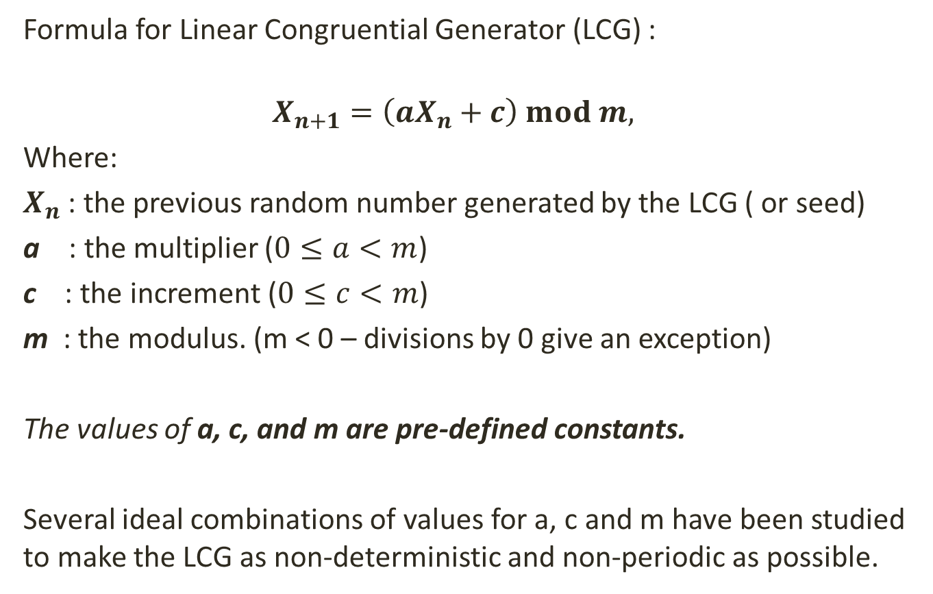
Linear Congruential RNG
Formula for Linear Congruential Generator (LCG) :
$$X_{n+1}=\left(aX_{n}+c\right) mod m,$$
Where:
$X_{n}$: the previous random number generated by the LCG ( or seed)
a : the multiplier ($0≤a<m$)
c : the increment ($0≤c<m$)
m : the modulus. (m < 0 – divisions by 0 give an exception)
The values of a, c, and m are pre-defined constants.
Several ideal combinations of values for a, c and m have been studied to make the LCG as non-deterministic and non-periodic as possible.
12
Notes:
5/5/2020
12
12
(See table on Wikipedia for LCG: https://en.wikipedia.org/wiki/Linear_congruential_generator)

Slide 13
Linear Congruential RNG
Formula for Linear Congruential Generator (LCG) :
$$X_{n+1}=\left(aX_{n}+c\right) mod m,$$
Where:
$X_{n}$: the previous random number generated by the LCG ( or seed)
a : the multiplier ($0≤a<m$)
c : the increment ($0≤c<m$)
m : the modulus. (m < 0 – divisions by 0 give an exception)
The values of a, c, and m are pre-defined constants.
Several ideal combinations of values for a, c and m have been studied to make the LCG as non-deterministic and non-periodic as possible.
13
Notes:
5/5/2020
13
13
(See table on Wikipedia for LCG: https://en.wikipedia.org/wiki/Linear_congruential_generator)

Slide 14
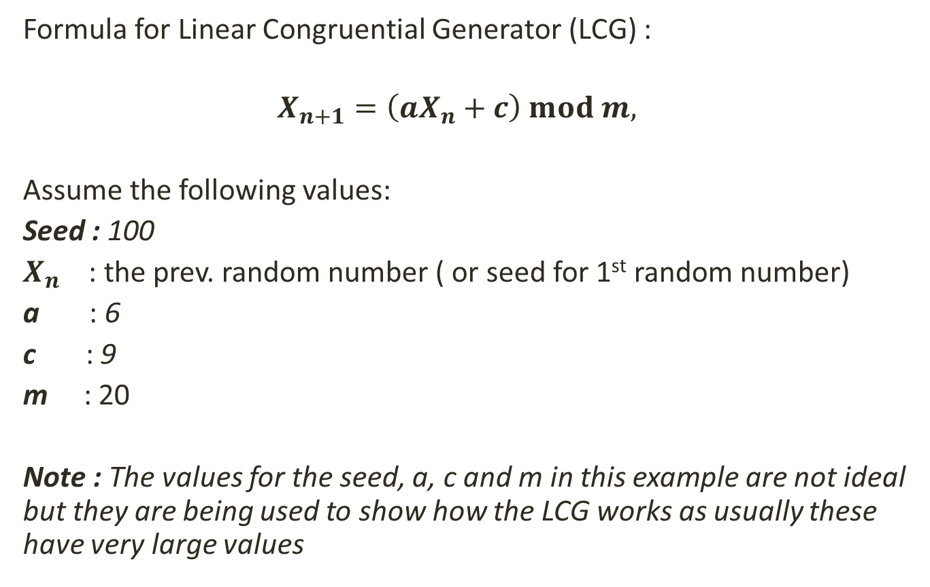
Linear Congruential RNG
Formula for Linear Congruential Generator (LCG) :
$$X_{n+1}=\left(aX_{n}+c\right) mod m,$$
Assume the following values:
Seed : 100
$X_{n}$: the prev. random number ( or seed for 1st random number)
a : 6
c : 9
m : 20
Note : The values for the seed, a, c and m in this example are not ideal but they are being used to show how the LCG works as usually these have very large values
14
Notes:
5/5/2020
14
14

Slide 15
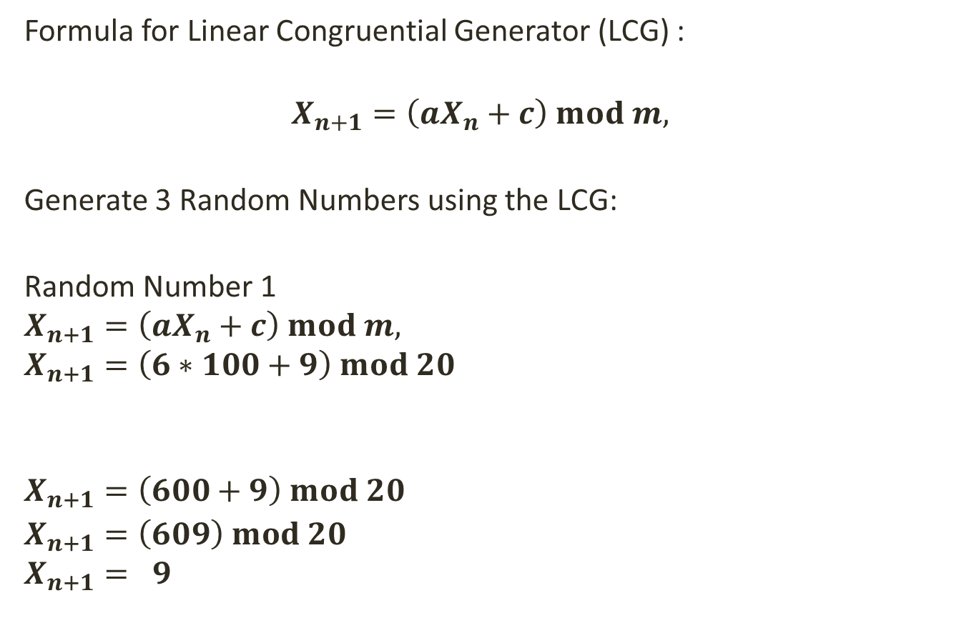
Linear Congruential RNG
Formula for Linear Congruential Generator (LCG) :
$$X_{n+1}=\left(aX_{n}+c\right) mod m,$$
Generate 3 Random Numbers using the LCG:
Random Number 1
$$X_{n+1}=\left(aX_{n}+c\right) mod m,$$
$$X_{n+1}=\left(6∗100+9\right) mod 20$$
$$X_{n+1}=\left(600+9\right) mod 20$$
$X_{n+1}=\left(609\right) mod 20$
$$X_{n+1}= 9$$
Since this is our 1st random number the prev. random number is considered to be the seed
609 mod 20 = 30 r 9
But mod only takes the remainder
15
Notes:
5/5/2020
15
15

Slide 16
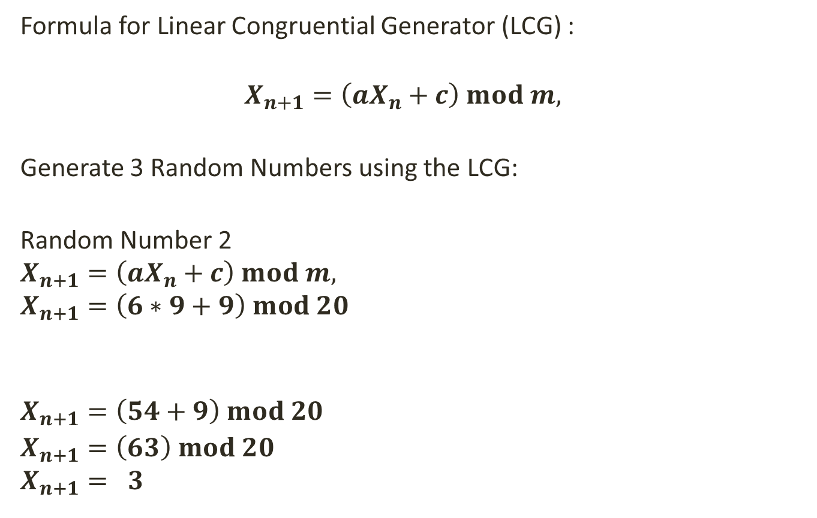
Linear Congruential RNG
Formula for Linear Congruential Generator (LCG) :
$$X_{n+1}=\left(aX_{n}+c\right) mod m,$$
Generate 3 Random Numbers using the LCG:
Random Number 2
$$X_{n+1}=\left(aX_{n}+c\right) mod m,$$
$$X_{n+1}=\left(6∗9+9\right) mod 20$$
$$X_{n+1}=\left(54+9\right) mod 20$$
$X_{n+1}=\left(63\right) mod 20$
$$X_{n+1}= 3$$
Since this is our 2nd random number, this will be generated on the prev. random number i.e. 9
63 mod 20 = 3 r 3
But mod only takes the remainder
16
Notes:
5/5/2020
16
16

Slide 17

Linear Congruential RNG
Formula for Linear Congruential Generator (LCG) :
$$X_{n+1}=\left(aX_{n}+c\right) mod m,$$
Generate 3 Random Numbers using the LCG:
Random Number 3
$$X_{n+1}=\left(aX_{n}+c\right) mod m,$$
$$X_{n+1}=\left(6∗3+9\right) mod 20$$
$$X_{n+1}=\left(18+9\right) mod 20$$
$X_{n+1}=\left(27\right) mod 20$
$$X_{n+1}= 7$$
Since this is our 3rd random number, this will be generated on the prev. random number i.e. 3
27 mod 20 = 1 r 7
But mod only takes the remainder
17
Notes:
5/5/2020
17
17

Slide 18
Linear Congruential RNG
Pseudo-Code for Linear Congruential Generator (LCG) :
In class for LCG, determine the values for :
Seed → Current time in milliseconds
Multiplier A
Increment C
Modulus M
Prev. Random Number Xn = Seed
Function GenerateRandomNumber() : int
Random Number R = (A * Xn + C) % M
Set Xn = R so that it is the seed for the next random number
Return Random Number R
18
Notes:
5/5/2020
18
18

Slide 19
Linear Congruential RNG
The Linear Congruential Generator (LCG) is a simple RNG which can produce a good variety or pseudo random numbers but…
It is very sensitive to the values selected for a, c and m
Selecting sub-optimal values for these constants may lead to poor generation of random numbers and high periodicity.
It is will repeat the same sequence of random numbers after m+1 random number generations
This is because the range of values for random numbers depends on the modulus (m). In addition, the next random number depends on the random number that has just been generated.
Therefore the larger the value of m in the LCG the less periodic the RNG is.
19
Notes:
5/5/2020
19
19

Slide 20
Lagged Fibonacci RNG
The Lagged Fibonacci RNG (LFG) is aimed as an improvement to the 'standard' Linear Congruential Method.
In this case, the new random number being generated does not depend on the previously generated random number, but rather on a combination of two previously generated random numbers.
These 2 previously generated random numbers are obtained for a pre-defined array of random numbers known as the initial set of k states
20
Notes:
5/5/2020
20
20

Slide 21
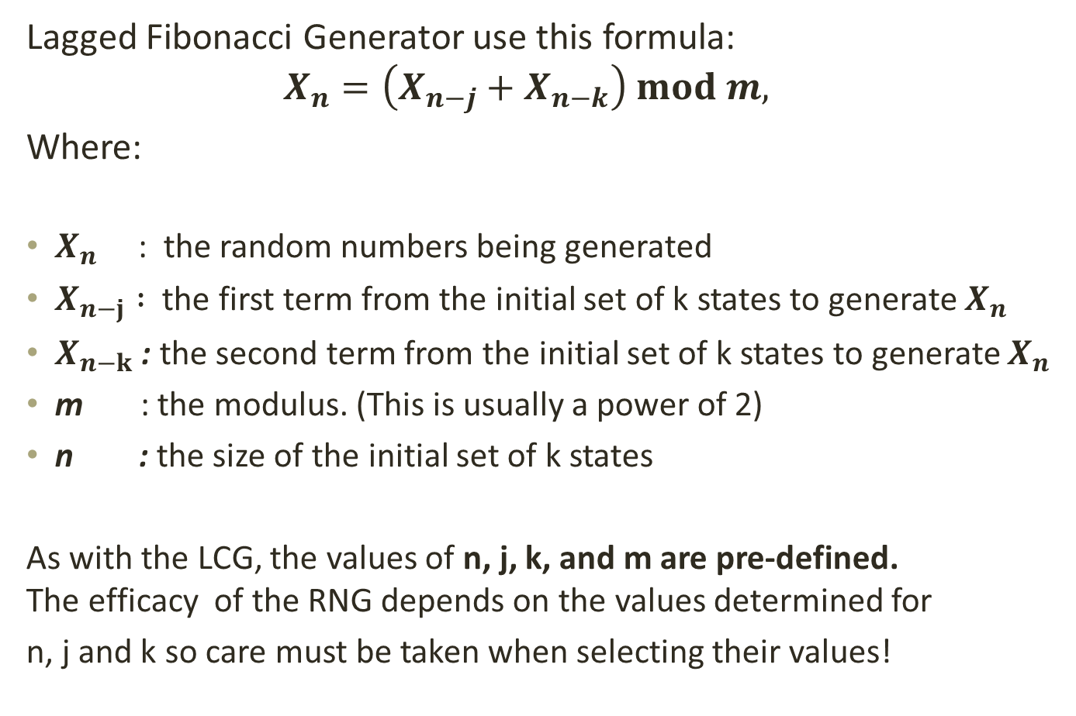
Lagged Fibonacci RNG
Lagged Fibonacci Generator use this formula:
$$X_{n}=\left(X_{n−j}+X_{n−k}\right) mod m,$$
Where:
$X_{n}$ : the random numbers being generated
$X_{n−j} :$ the first term from the initial set of k states to generate $X_{n}$
$X_{n−k}$ : the second term from the initial set of k states to generate $X_{n}$
m : the modulus. (This is usually a power of 2)
n : the size of the initial set of k states
As with the LCG, the values of n, j, k, and m are pre-defined. The efficacy of the RNG depends on the values determined for
n, j and k so care must be taken when selecting their values!
21
Notes:
5/5/2020
21
21

Slide 22
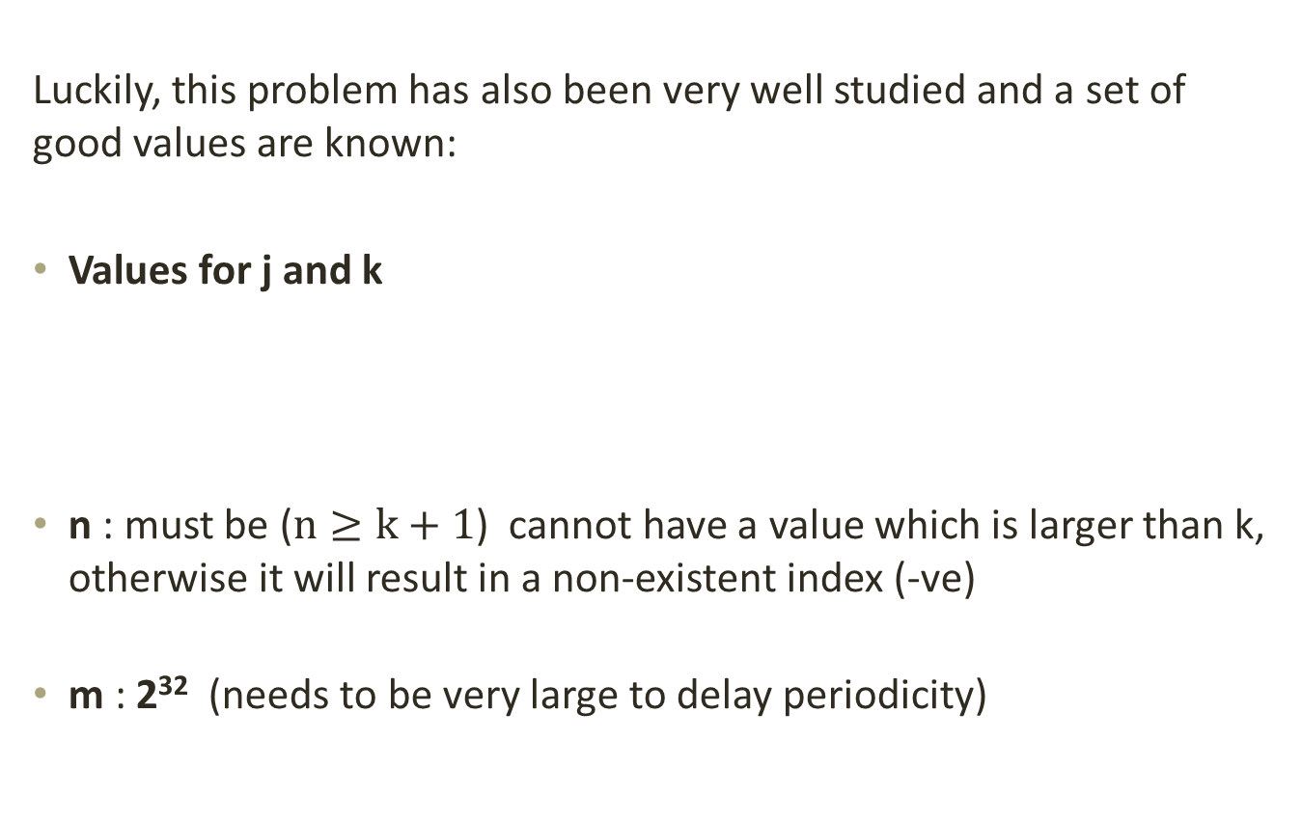
Lagged Fibonacci RNG
Luckily, this problem has also been very well studied and a set of good values are known:
Values for j and k
n : must be ($n≥k+1$) cannot have a value which is larger than k, otherwise it will result in a non-existent index (-ve)
m : 2³² (needs to be very large to delay periodicity)
J | 24 | 38 | 37 | 30 | 83 | 107 | 273 | 1029
K | 55 | 89 | 100 | 127 | 258 | 378 | 607 | 2281
22
Notes:
5/5/2020
22
22

Slide 23
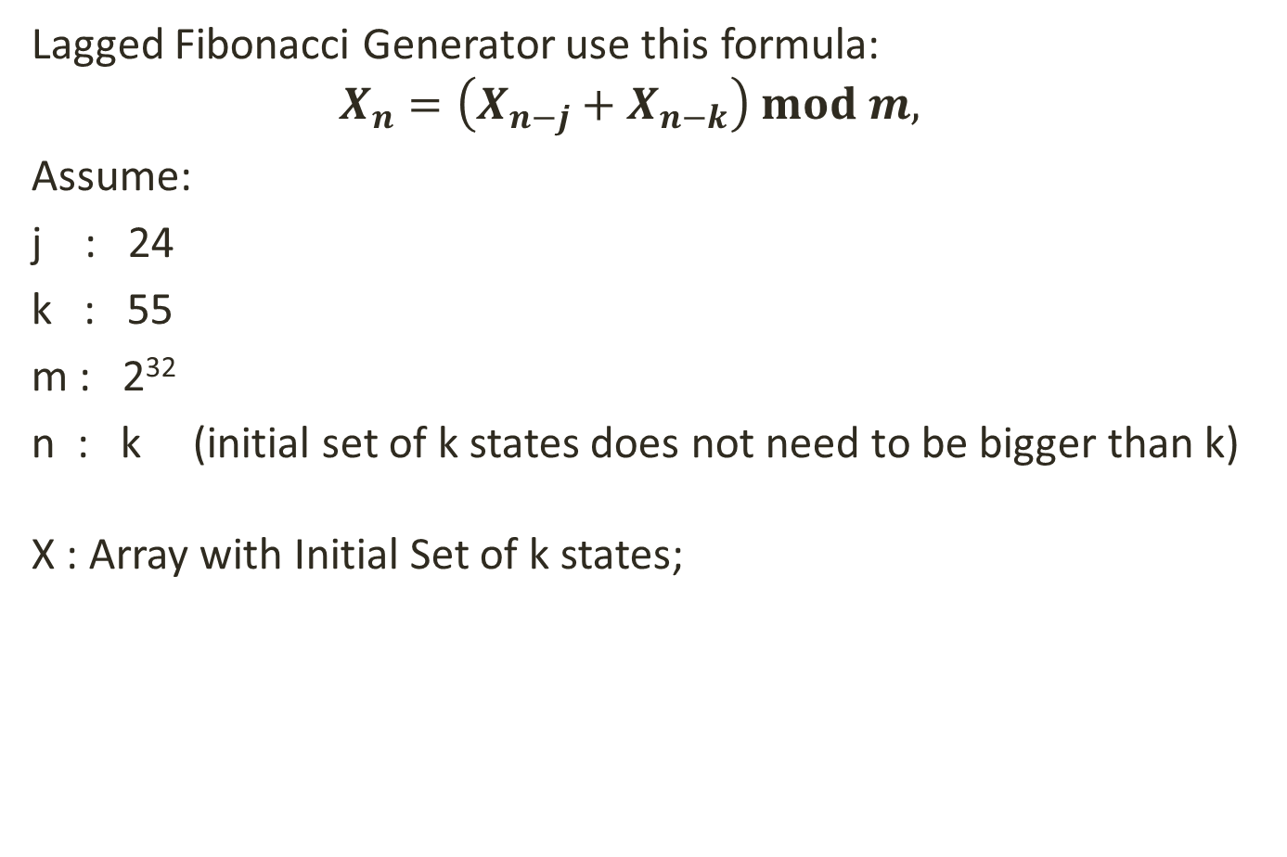
Lagged Fibonacci RNG
Lagged Fibonacci Generator use this formula:
$$X_{n}=\left(X_{n−j}+X_{n−k}\right) mod m,$$
Assume:
j : 24
k : 55
m : 2³²
n : k (initial set of k states does not need to be bigger than k) X : Array with Initial Set of k states;
0
1
2
3
4
……
50
51
52
53
54
11 | 6 | 99 | 7 | 16 | …… | 20 | 141 | 86 | 3 | 456
23
Notes:
5/5/2020
23
23

Slide 24
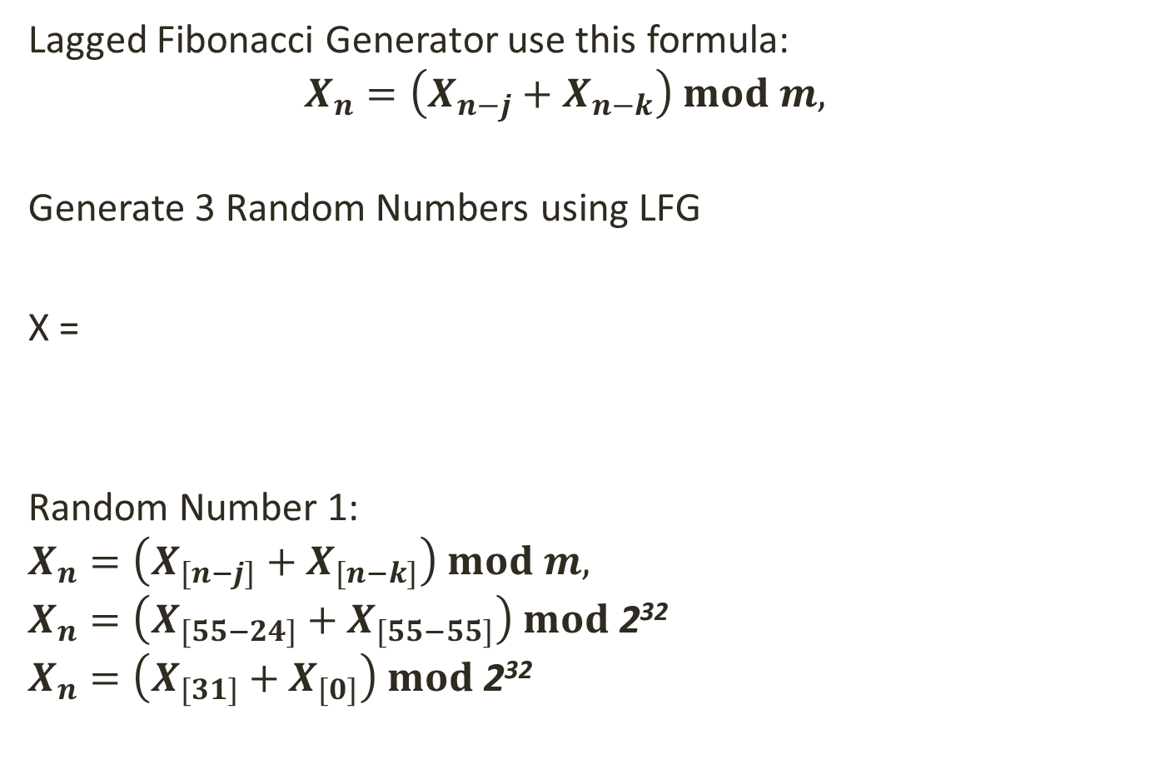
Lagged Fibonacci RNG
Lagged Fibonacci Generator use this formula:
$$X_{n}=\left(X_{n−j}+X_{n−k}\right) mod m,$$
Generate 3 Random Numbers using LFG
X =
Random Number 1:
$$X_{n}=\left(X_{[n−j]}+X_{[n−k]}\right) mod m,$$
$$X_{n}=\left(X_{[55−24]}+X_{[55−55]}\right) mod \text{2}\text{32}$$
$$X_{n}=\left(X_{[31]}+X_{[0]}\right) mod \text{2}\text{32}$$
0
1
2
……
31
……
50
51
52
53
54
11 | 6 | 99 | ….. | 16 | …… | 20 | 141 | 86 | 3 | 456
X[0]
X[31]
24
Notes:
5/5/2020
24
24

Slide 25
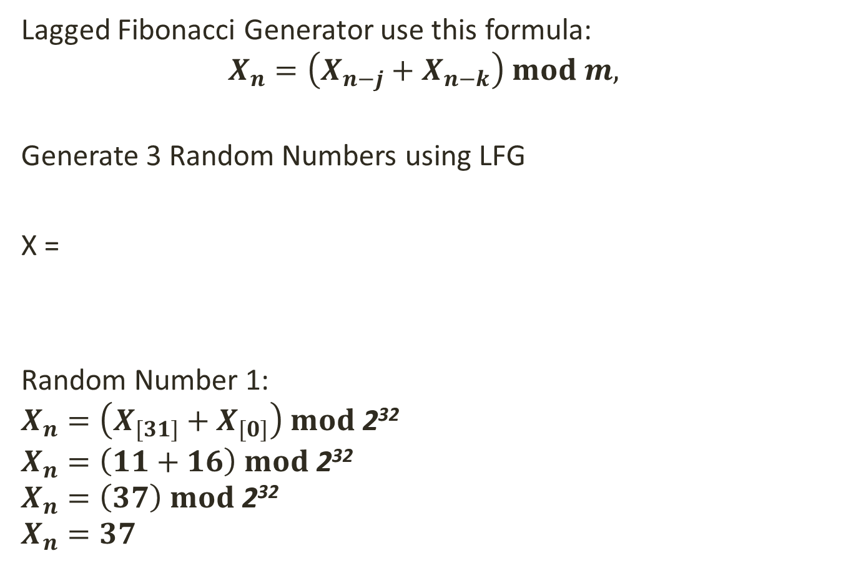
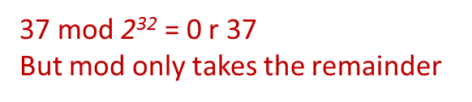
Lagged Fibonacci RNG
Lagged Fibonacci Generator use this formula:
$$X_{n}=\left(X_{n−j}+X_{n−k}\right) mod m,$$
Generate 3 Random Numbers using LFG
X =
Random Number 1:
$$X_{n}=\left(X_{[31]}+X_{[0]}\right) mod \text{2}\text{32}$$
$$X_{n}=\left(11+16\right) mod \text{2}\text{32}$$
$$X_{n}=\left(37\right) mod \text{2}\text{32}$$
$$X_{n}=37$$
0
1
2
……
31
……
50
51
52
53
54
11 | 6 | 99 | ….. | 16 | …… | 20 | 141 | 86 | 3 | 456
X[0]
X[31]
37 mod $\text{2}\text{32}$ = 0 r 37
But mod only takes the remainder
25
Notes:
5/5/2020
25
25

Slide 26
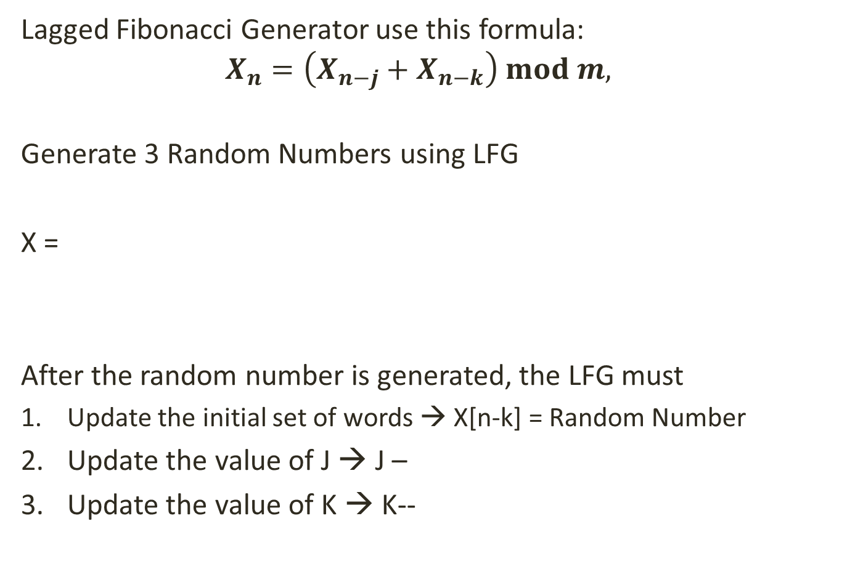
Lagged Fibonacci RNG
Lagged Fibonacci Generator use this formula:
$$X_{n}=\left(X_{n−j}+X_{n−k}\right) mod m,$$
Generate 3 Random Numbers using LFG
X =
After the random number is generated, the LFG must
Update the initial set of words → X[n-k] = Random Number
Update the value of J → J –
Update the value of K → K--
0
1
2
……
31
……
50
51
52
53
54
11 | 6 | 99 | ….. | 16 | …… | 20 | 141 | 86 | 3 | 456
37
X[0]
J = 24 – 1 Therefore J = 23
K = 55 - 1 Therefore K = 54
26
Notes:
5/5/2020
26
26

Slide 27

Lagged Fibonacci RNG
Lagged Fibonacci Generator use this formula:
$$X_{n}=\left(X_{n−j}+X_{n−k}\right) mod m,$$
Generate 3 Random Numbers using LFG
X =
Random Number 2:
$$X_{n}=\left(X_{[n−j]}+X_{[n−k]}\right) mod m,$$
$$X_{n}=\left(X_{[55−23]}+X_{[55−54]}\right) mod \text{2}\text{32}$$
$$X_{n}=\left(X_{[32]}+X_{[1]}\right) mod \text{2}\text{32}$$
0
1
2
……
31
32
……
51
52
53
54
37 | 6 | 99 | ….. | 16 | 20 | …… | 141 | 86 | 3 | 456
X[0]
X[31]
27
Notes:
5/5/2020
27
27

Slide 28
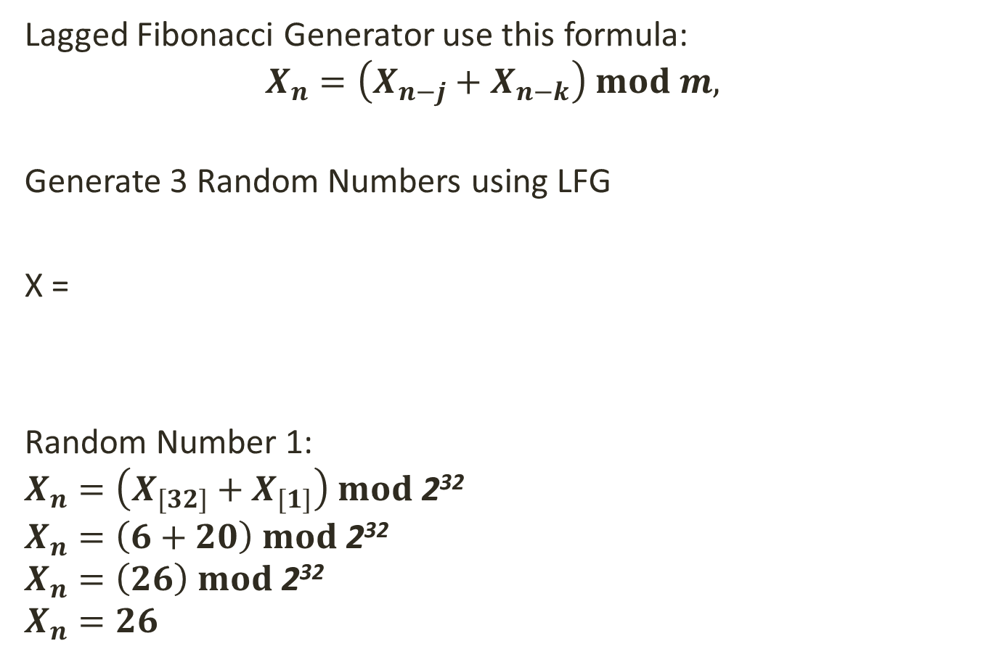
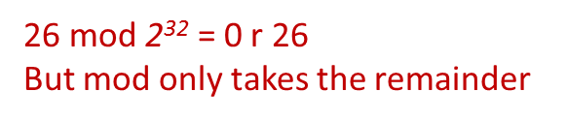
Lagged Fibonacci RNG
Lagged Fibonacci Generator use this formula:
$$X_{n}=\left(X_{n−j}+X_{n−k}\right) mod m,$$
Generate 3 Random Numbers using LFG
X =
Random Number 1:
$$X_{n}=\left(X_{[32]}+X_{[1]}\right) mod \text{2}\text{32}$$
$$X_{n}=\left(6+20\right) mod \text{2}\text{32}$$
$$X_{n}=\left(26\right) mod \text{2}\text{32}$$
$$X_{n}=26$$
0
1
2
……
31
32
……
51
52
53
54
37 | 6 | 99 | ….. | 16 | 20 | 20 | 141 | 86 | 3 | 456
X[1]
X[32]
26 mod $\text{2}\text{32}$ = 0 r 26
But mod only takes the remainder
28
Notes:
5/5/2020
28
28

Slide 29
Lagged Fibonacci RNG
Lagged Fibonacci Generator use this formula:
$$X_{n}=\left(X_{n−j}+X_{n−k}\right) mod m,$$
Generate 3 Random Numbers using LFG
X =
After the random number is generated, the LFG must
Update the initial set of words → X[n-k] = Random Number
Update the value of J → J –
Update the value of K → K--
0
1
2
……
31
……
50
51
52
53
54
37 | 6 | 99 | ….. | 16 | …… | 20 | 141 | 86 | 3 | 456
26
X[1]
J = 23 – 1 Therefore J = 22
K = 54 - 1 Therefore K = 53
29
Notes:
5/5/2020
29
29

Slide 30
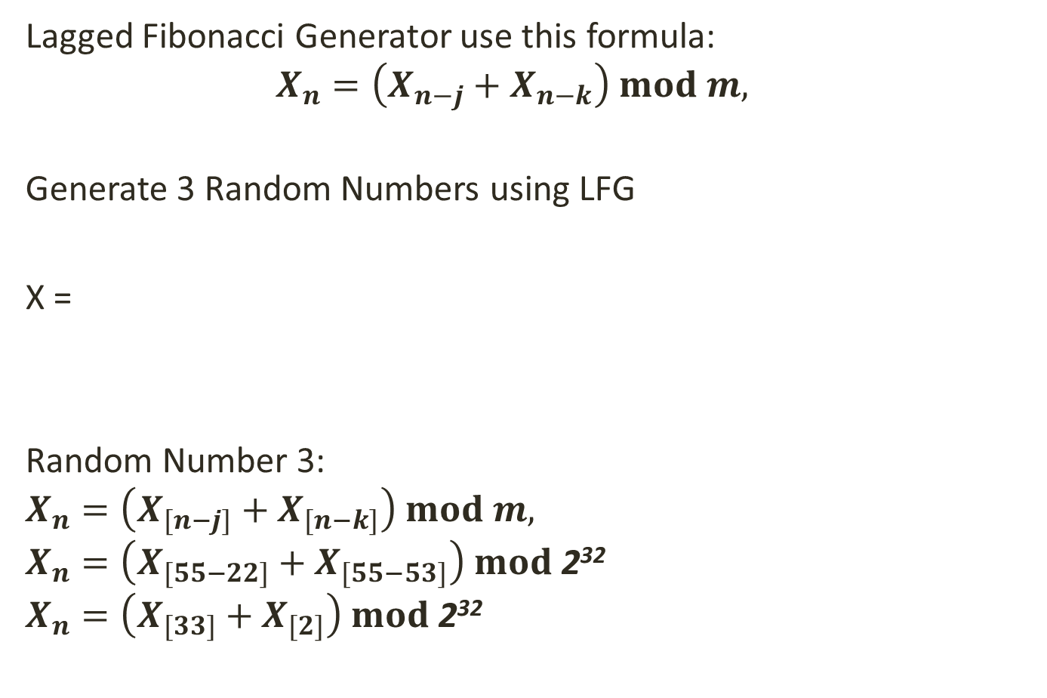
Lagged Fibonacci RNG
Lagged Fibonacci Generator use this formula:
$$X_{n}=\left(X_{n−j}+X_{n−k}\right) mod m,$$
Generate 3 Random Numbers using LFG
X =
Random Number 3:
$$X_{n}=\left(X_{[n−j]}+X_{[n−k]}\right) mod m,$$
$$X_{n}=\left(X_{[55−22]}+X_{[55−53]}\right) mod \text{2}\text{32}$$
$$X_{n}=\left(X_{[33]}+X_{[2]}\right) mod \text{2}\text{32}$$
0
1
2
……
31
32
33
……
52
53
54
37 | 26 | 99 | ….. | 16 | 20 | 141 | ….. | 86 | 3 | 456
X[2]
X[33]
30
Notes:
5/5/2020
30
30

Slide 31
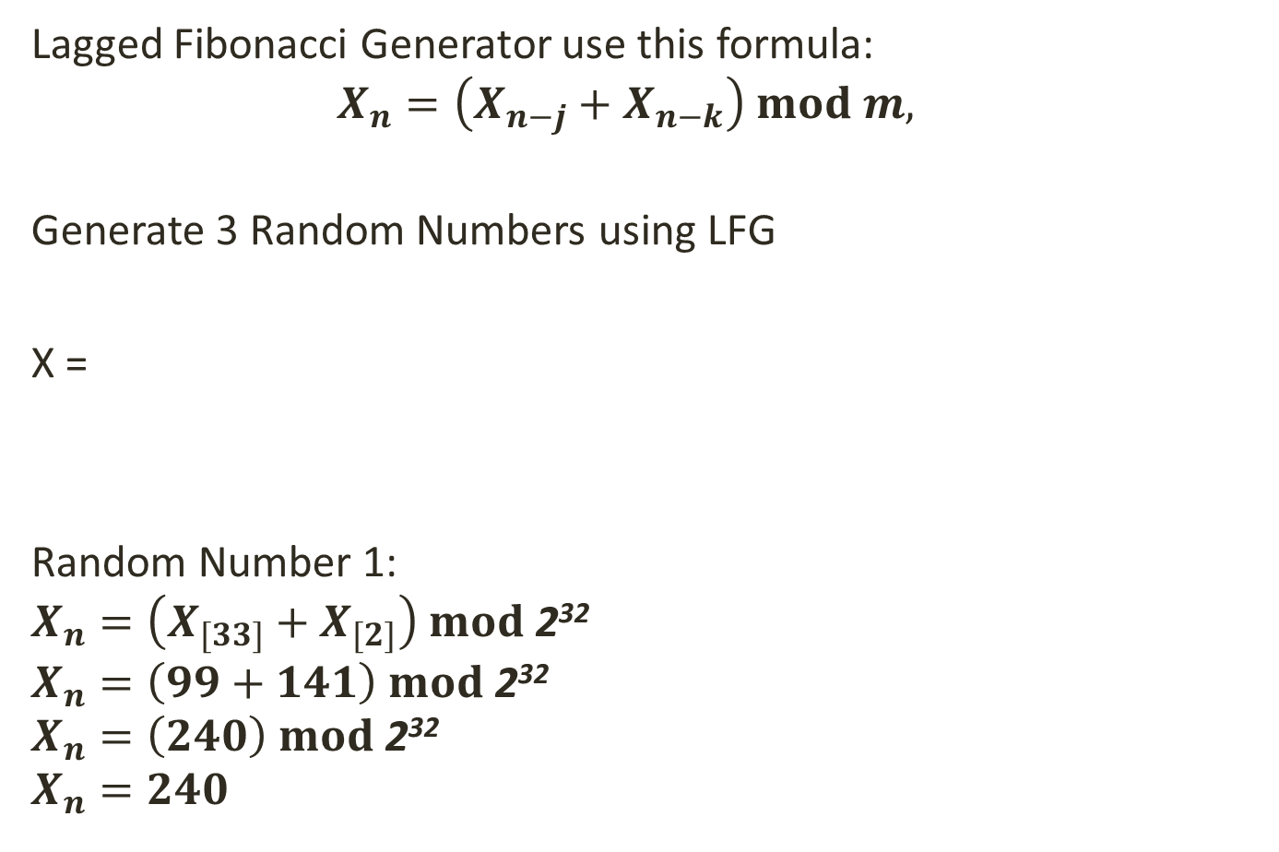
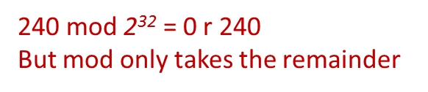
Lagged Fibonacci RNG
Lagged Fibonacci Generator use this formula:
$$X_{n}=\left(X_{n−j}+X_{n−k}\right) mod m,$$
Generate 3 Random Numbers using LFG
X =
Random Number 1:
$$X_{n}=\left(X_{[33]}+X_{[2]}\right) mod \text{2}\text{32}$$
$$X_{n}=\left(99+141\right) mod \text{2}\text{32}$$
$$X_{n}=\left(240\right) mod \text{2}\text{32}$$
$$X_{n}=240$$
0
1
2
……
31
32
33
……
52
53
54
37 | 26 | 99 | ….. | 16 | 20 | 141 | …. | 86 | 3 | 456
X[2]
X[33]
240 mod $\text{2}\text{32}$ = 0 r 240
But mod only takes the remainder
31
Notes:
5/5/2020
31
31

Slide 32

Lagged Fibonacci RNG
Lagged Fibonacci Generator use this formula:
$$X_{n}=\left(X_{n−j}+X_{n−k}\right) mod m,$$
Generate 3 Random Numbers using LFG
X =
After the random number is generated, the LFG must
Update the initial set of words → X[n-k] = Random Number
Update the value of J → J –
Update the value of K → K++
0
1
2
……
31
……
50
51
52
53
54
37 | 6 | 99 | ….. | 16 | …… | 20 | 141 | 86 | 3 | 456
240
X[2]
J = 22 – 1 Therefore J = 21
K = 53 - 1 Therefore K = 52
32
Notes:
5/5/2020
32
32

Slide 33
Lagged Fibonacci RNG
Pseudo-Code for Lagged Fibonacci Generator (LFG) :
In class for LFG, determine the values for :
J, K and M
N = 0
Int [ ] X for initial set of k states
In Constructor for LFG
Set N equal to K
Initialize X to be an array of size N
Using an existing RNG e.g. C# inbuilt Random , Fill array X with random numbers
33
Notes:
5/5/2020
33
33

Slide 34
Lagged Fibonacci RNG
Pseudo-Code for Lagged Fibonacci Generator (LFG) :
Function GenerateRandomNumber() : int
IF J <= 1 THEN J → Optimal Value for J ELSE Decrement J
IF K <= 1 THEN K → Optimal Value for K ELSE Decrement K
Get the element E₁ at index N-J from array X i.e. initial set of K states
Get the element E₂ at index N-K from array X is.e. initial set of K states
New Random Number = (E₁ + E₂) mod M
Array X at index N-K = New Random Number
Return New Random Number
34
Notes:
5/5/2020
34
34

Slide 35
Lagged Fibonacci RNG
The LFG comes in a number of variations; substituting the + operator with another operator allows for different random numbers to be generated.
Variations of LFG
+ operator : Additive Lagged Fibonacci Generator
- operator : Subtractive Lagged Fibonacci Generator
* Operator : Multiplicative Lagged Fibonacci Generator
XOR operator : Two-tap Generalised Feedback Shift Register
35
Notes:
5/5/2020
35
35

Slide 36
Random Number Generation within Ranges
To return Random Numbers between 0 and a Maximum Value
Random Number R % (MaxValue+1) Example: Random Number Generated by RNG is 136 Random Number must be in range 0 to 20 Therefore : 136 % (20+1)
: 136 % 21
: 6 R 10 ( modulus returns only the remainder part)
Final Random Number in range 0 to 20 is 10
36
Notes:
5/5/2020
36
36

Slide 37
Random Number Generation within Ranges
To return Random Numbers between Minimum and Maximum Value
MinValue + Random Number R % (MaxValue+1-MinValue)
Example: Random Number Generated by RNG is 136 Random Number must be in range 11 to 20 Therefore : 11 + 136 % (20 + 1 - 11)
: 11 + 136 % (10)
: 11 + 130 R 6 ( modulus returns only the remainder part)
: 11 + 6
: 17
Final Random Number in range 11 to 20 is 17
37
Notes:
5/5/2020
37
37

Slide 38
End of lesson
Any questions?

